Slide 1


CASA Ask the Experts:
Partnering on PFAS Workshop Introduction
Jared Voskuhl, CASA
April 27, 2022

Slide 2
PFAS is Ubiquitous When Measuring Presence
PFAS exposure is a health concern
Detectable serum PFASs
Non-detect

Slide 3
Products Containing PFAS
Baby products
Sunscreens
Water resistant clothing & apparel
Household consumer products
Paper products
Home appliances
Automotive products
Medical technology
Rechargeable batteries
Car & floor waxes
Plastic water bottles
Toys
Smart phones and tablets
Cleaning products
Fast-food wrappers, containers, & other grease-resistant paper
Microwave popcorn bags
Pizza boxes
Candy wrappers
Nonstick cookware
Stain-resistant coatings for carpets or upholstery
Wrinkle & stain resistant clothing
Surfboard & snowboard wax

Slide 4
Median PFAS Concentrations Across Media
Hall et al. “Per- and Polyfluoroalkyl substances in Dust Collected from Houses and Fire Stations in North America. Fluorinated Compounds in North American Cosmetics.” Environmental Science and Technology (2020) 14558-14567
Whitehead et al. “Fluorinated Compounds in North American Cosmetics.” Environmental Science and Technology Letters (2021)
R2 SF RWQCB-SFEI-BACWA Phase 1 Study

Slide 5


Source Identification & Source Control
Pollution Prevention
Societal Cost
Efficacy
Remediation

Slide 6
Biomonitoring Data Shows Significant Decreases in Blood Serum after PFOS and PFOA were phased out
80% decrease for PFOS, 55% decrease in PFOA

Slide 7
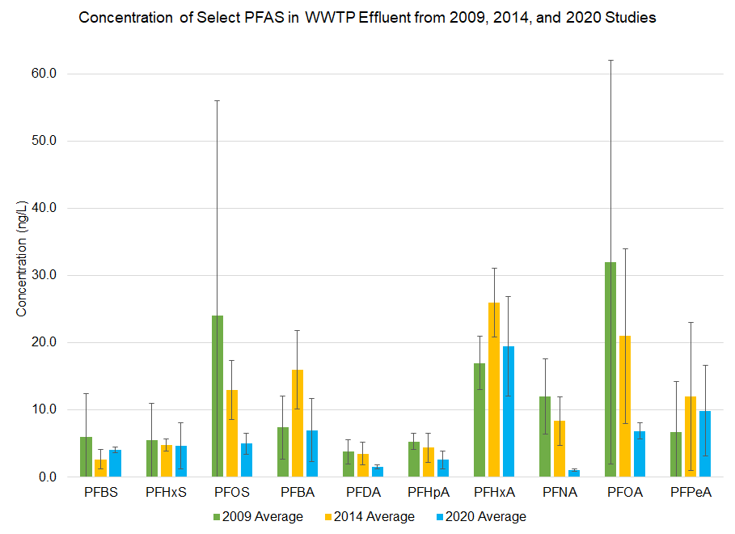
Long Chain Compounds Decreased in Bay Area Effluent over 12 years
3 facilities with historic effluent data
Decrease in PFOS, PFOA, and PFNA
?
?
?
Graph and study information courtesy of Diana Lin and SFEI

Slide 8
CASA-CWA-EWG Sponsored PFAS Disclosure Legislation
2022 – AB 2247 (Bloom) PFAS Product Disclosure
Manufacturers of products containing PFAS would be required to register on the
Interstate Chemical Clearinghouse (IC2) and certify with CalEPA the information.
Information would include the identity and quantity of PFAS in single-products.
When analytes are detected by POTWs through regulatory monitoring, the IC2 could be referenced to identify prospective residential or commercial sources.
8

