Slide 1
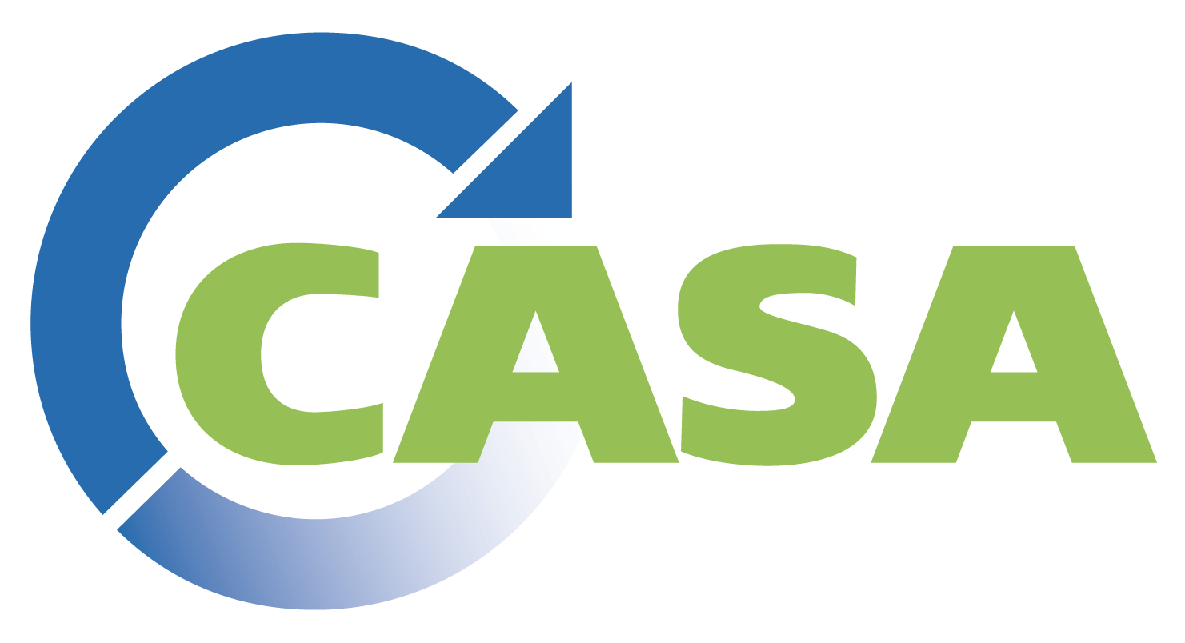
Overview of Federal PFAS Priorities & Initiatives
Sarah Sapirstein
Federal Legislative and Policy Analyst
California Association of Sanitation Agencies

Slide 2
Federal Initiatives
U.S. Environmental Protection Agency (USEPA)
  PFAS Strategic Roadmap
  CERLCA Designation
  Biosolids Risk Assessment
  Analytical Testing Methods
Congress
  Senate Proposal
  Bipartisan Infrastructure Law
  Appropriations

Slide 3
USEPA: Upcoming Regulatory Decisions
Office of Water
  Industrial Release Restrictions
  NPDES Permit Term Requirements
  Biosolids Risk Assessment
  Analytical Methods
Office of Land and Emergency Management
  CERCLA Designation

Slide 4
USEPA: CERCLA Designation
Proposed CERCLA Designation Rule (expected spring 2022)
Final rule expected summer 2023
OMB Reviewing Proposed Rule
Stakeholder Effort for Liability Exemption

Slide 5
USEPA: Biosolids Risk Assessment
Risk Assessment For PFOA And PFOS In Biosolids
Basis For Future Regulatory Decisions
Expected Deadline Winter 2024

Slide 6
USEPA: Testing Methods
Publish improved analytical methods for 40 PFAS chemicals (expected Fall 2022/Fall 2024)
Provide consistent tested PFAS method and contains required quality control procedures for the Clean Water Act.
Developing human health toxicity standards to assist decisions managing PFAS to protect human health and the environment.

Slide 7
USEPA: Analytical Testing Methods
USEPA: Analytical Methods Testing
Congress
  Validating methods to measure certain PFAS in groundwater, surface water, wastewater, and solids (e.g., soils, sediments, and sewage).
  Developing human health toxicity reference values for specific PFAS to enable risk assessors make decisions about managing PFAS to protect human health and the environment.
Awaiting Senate Proposal
Bipartisan Infrastructure Law
  $1 B Clean Water SRF PFAS Funds
USEPA FY 2022 Omnibus
  Encourages USEPA to continue with PFAS-related activities:
    Research
    Clean-up
    Rulemakings

Slide 8

Questions

