Slide 1
What can we learn from the GeoTracker PFAS data?
Chris Gurr, PE
CDM Smith
April 26, 2022

Slide 2
Experimental Methods & Provisional Data Quality
USEPA guidance indicates that monitoring should not be commenced or required until after a multi- lab validated method is made available to the public. In addition, USEPA’s criteria for certifying a new standard method requires a thorough demonstration of accuracy, precision, representativeness, ruggedness, and comparability. Because no USEPA certified or approved standard analytical test method currently exists for PFAS in non-potable water [and/or solid matrices], the data submitted herein should be considered as provisional.
The data is not intended for any regulatory purpose other than in response to the State Water Board’s Order, and should not be used for any other compliance or regulatory purpose under any statutory or regulatory scheme, including, but not limited to the federal Clean Water Act, the Safe Drinking Water Act, and/or the Porter- Cologne Water Quality Control Act.
40 CFR 136 / USEPA
Experimental, non-approved methods
Frequency of Non-detects

Slide 3
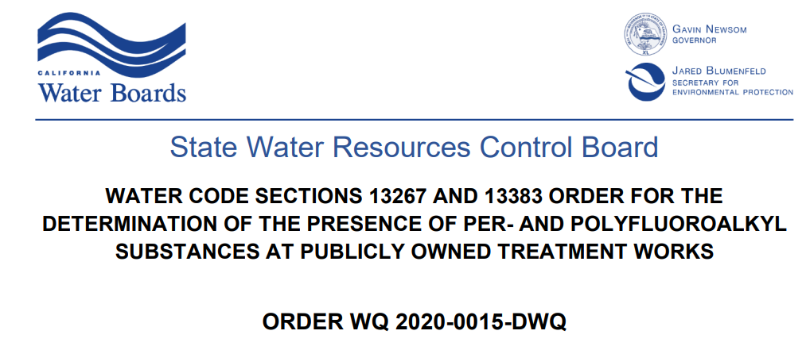

Slide 4
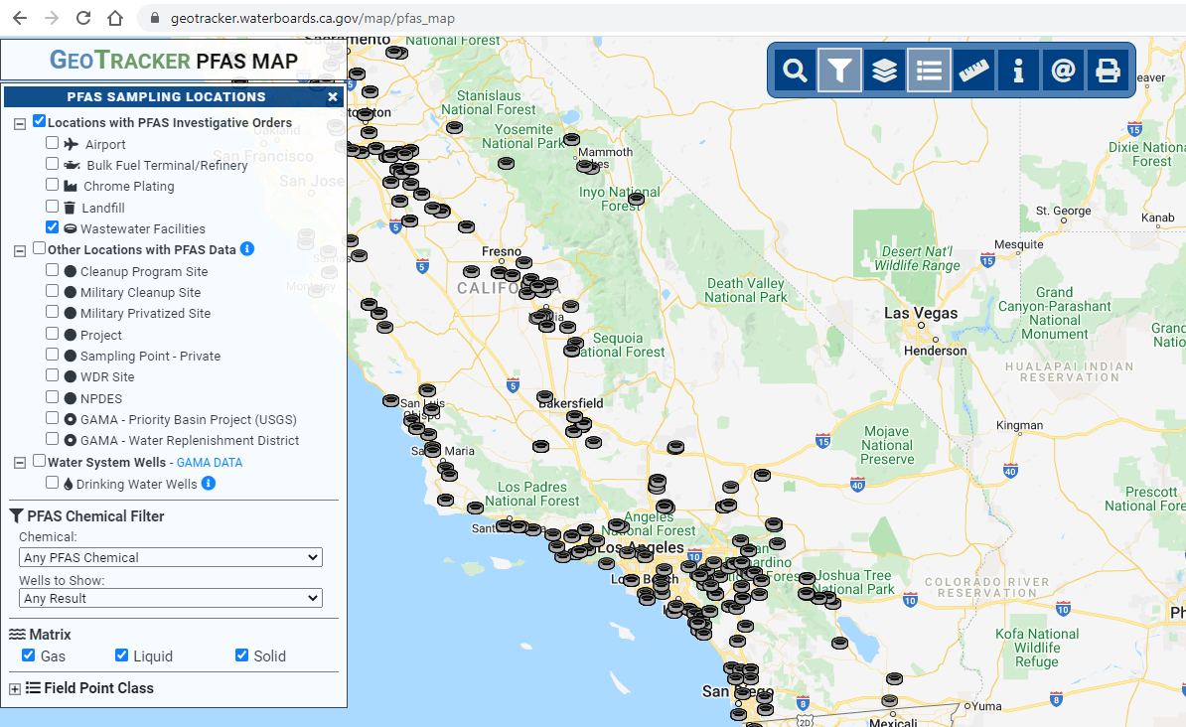

Slide 5
Alphabet Soup
Chemical | ChainType | Subclass | Chain Length
PFBA | Short Chain | PFCA | C004
PFPeA | Short Chain | PFCA | C005
PFHxA | Short Chain | PFCA | C006
PFHpA | Short Chain | PFCA | C007
PFOA | Long Chain | PFCA | C008
PFNA | Long Chain | PFCA | C009
PFDA | Long Chain | PFCA | C010
PFUnDA | Long Chain | PFCA | C011
PFDoDA | Long Chain | PFCA | C012
PFTrDA | Long Chain | PFCA | C013
PRTeDA | Long Chain | PFCA | C014
PFHxDA | Long Chain | PFCA | C016
PFODA | Long Chain | PFCA | C018
3:3FTCA | Short Chain | PFCA- Precursor | Short Chain
4:2FTS | Short Chain | PFCA- Precursor | Short Chain
5:3FTCA | Short Chain | PFCA- Precursor | Short Chain
6:2FTS | Short Chain | PFCA- Precursor | Short Chain
7:3FTCA | Long Chain | PFCA- Precursor | Long Chain
8:2FTS | Long Chain | PFCA- Precursor | Long Chain
10:2FTS | Long Chain | PFCA- Precursor | Long Chain
10:2FTS | Long Chain | PFCA- Precursor | Long Chain
Chemical | ChainType | Subclass | Chain Length
PFBS | Short Chain | PFSA | C004
PFPeS | Short Chain | PFSA | C005
PFHxS | Short Chain | PFSA | C006
PFHpS | Long Chain | PFSA | C007
PFOS | Long Chain | PFSA | C008
PFNS | Long Chain | PFSA | C009
PFDS | Long Chain | PFSA | C010
PFDOS | Long Chain | PFSA | C012
ETFOSA | Long Chain | PFSA- Precursor | Long Chain
ETFOSE | Long Chain | PFSA- Precursor | Long Chain
MEFOSA | Long Chain | PFSA- Precursor | Long Chain
MEFOSE | Long Chain | PFSA- Precursor | Long Chain
NETFOSAA | Long Chain | PFSA- Precursor | Long Chain
NMEFOSAA | Long Chain | PFSA- Precursor | Long Chain
PFOSA | Long Chain | PFSA- Precursor | Long Chain
11ClPF3OUDS | Long Chain | Per or Polyfluoroether | Long Chain
9ClPF3ONS | Long Chain | Per or Polyfluoroether | Long Chain
ADONA | Long Chain | Per or Polyfluoroether | Long Chain
HFPO-DA | Long Chain | Per or Polyfluoroether | Long Chain
HFPO-DA | Long Chain | Per or Polyfluoroether | Long Chain

Slide 6
Research Questions
What is a PFAS “baseline” for POTWs?
Do industrial discharges create PFAS above baseline?
Are there PFAS signatures of industrial point sources?
Where are the “outliers”?
What are the blind spots or major uncertainties in the dataset?

Slide 7
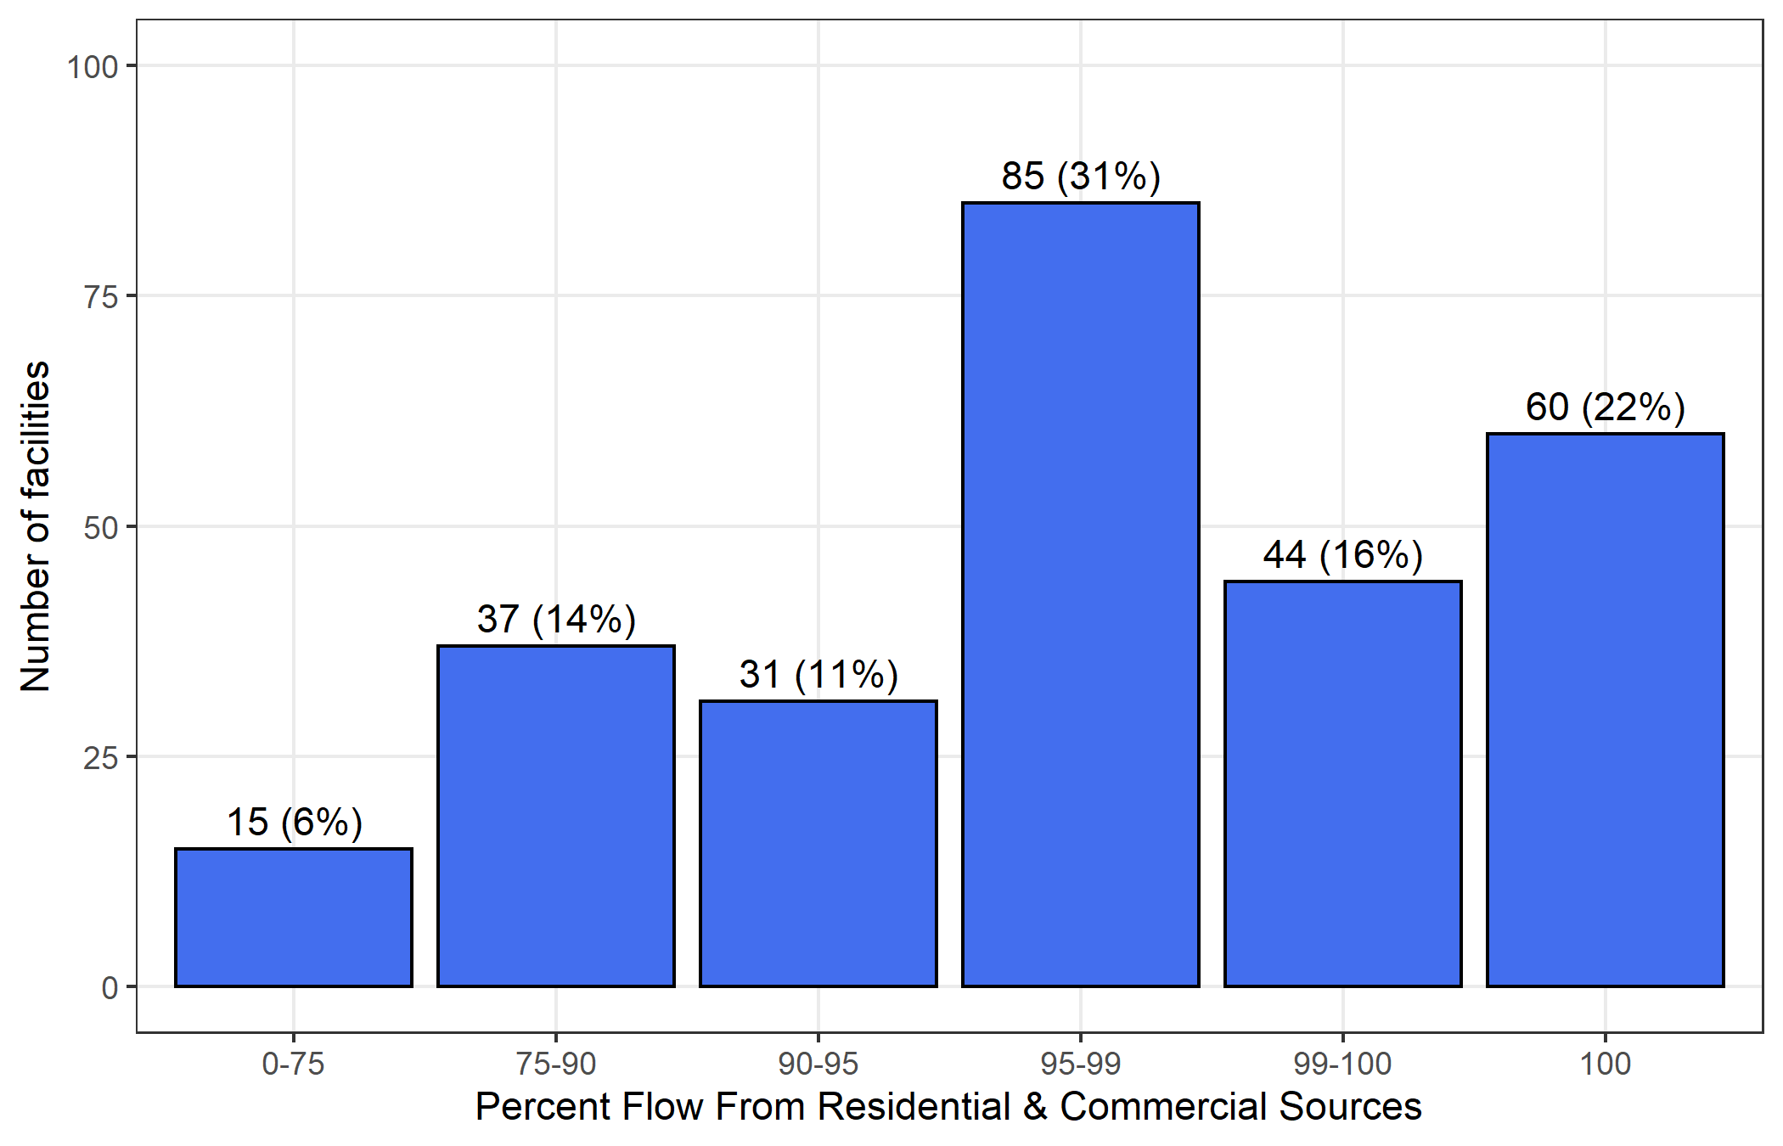
POTWs Distribution by Residential & Commercial Contribution
Total of 272 facilities
80% < 10% Industrial Contribution

Slide 8
Research Questions
What is a PFAS “baseline” for POTWs?
Do industrial discharges create PFAS above baseline?
Are there PFAS signatures of industrial point sources?
Where are the “outliers”?
What are the blind spots or major uncertainties in the dataset?

Slide 9
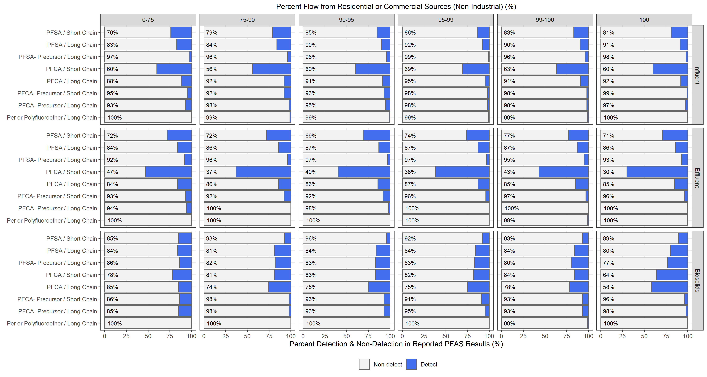
Wastestream PFAS Profile by Residential & Commercial Contribution

Slide 10
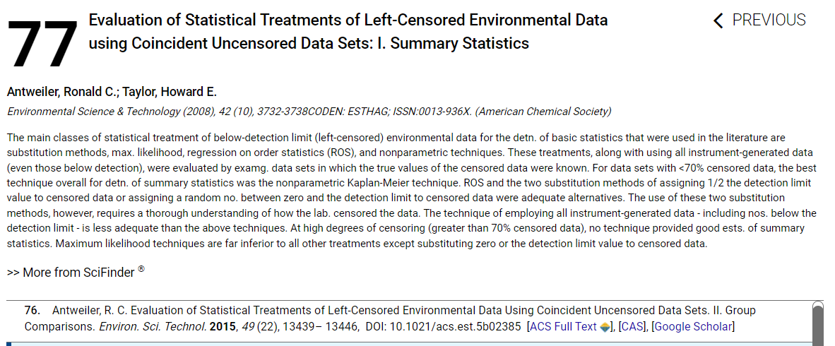

Slide 11
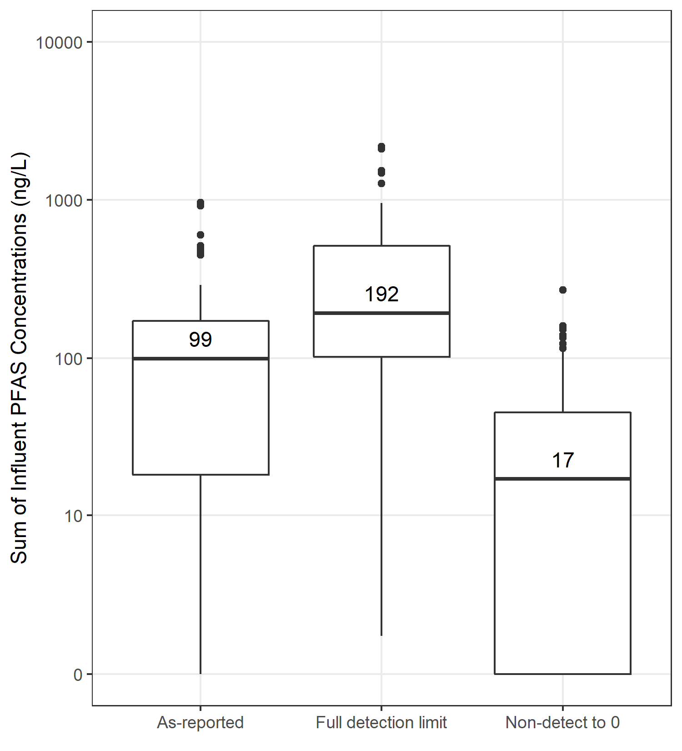
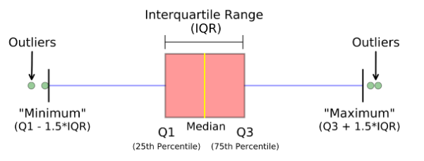
Sensitivity to NDs Quantification
State-wide samples
POTWs with 100% residential & commercial flow
Examples: 3 approaches handling NDs when calculating ∑quantified PFAS
“As-reported” = use values as shown on the GeoTracker. Depending on the laboratory performing the analysis, some NDs were reported as 0, some as the Detection Limit.
“Full detection limit” = values for NDs are substituted with the Detection Limit reported by the laboratory.
“Non-detect to 0” = All NDs treated as 0 nanograms per Liter (liquids) or micrograms per kilogram (solids)

Slide 12
Analyte Median Sensitivity to NDs Quantification
Influent samples
All POTWs
Analyte | Group | Percent of samples with Reporting Limits less than the Order requirements (%) | Median Concentration (ppt)
Analyte |  | % reporting limit (i.e. how confident are we in this concentration) | As-reported | Full detection limit | Non-detects to 0
PFBS | PFSA / Short Chain | 42 | 2.03 | 5 | 0
PFHxS | PFSA / Short Chain | 42 | 1.9 | 5 | 0
PFOS | PFSA / Long Chain | 42 | 2.64 | 5 | 0
PFHxA | PFCA / Short Chain | 50 | 6.64 | 8.6 | 3.88
PFHpA | PFCA / Short Chain | 41 | 1.81 | 5 | 0
PFOA | PFCA / Long Chain | 41 | 3.23 | 7.7 | 0
PFNA | PFCA / Long Chain | 41 | 0.9 | 4.66 | 0
PFDA | PFCA / Long Chain | 41 | 1 | 4.9 | 0
ADONA | Per or Polyfluoroether / Long Chain | 43 | 0.35 | 5 | 0

Slide 13
With so many NDs, how can we leverage distributions for PFAS rather than summary statistics?

Slide 14
Research Questions
What is a PFAS “baseline” for POTWs?
Do industrial discharges create PFAS above baseline?
Are there PFAS signatures of industrial point sources?
Where are the “outliers”?
What are the blind spots or major uncertainties in the dataset?

Slide 15
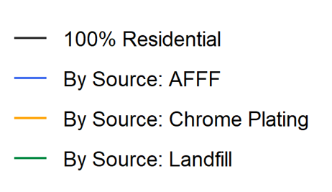
We Used Questionnaire Answers to Group POTWs

Slide 16
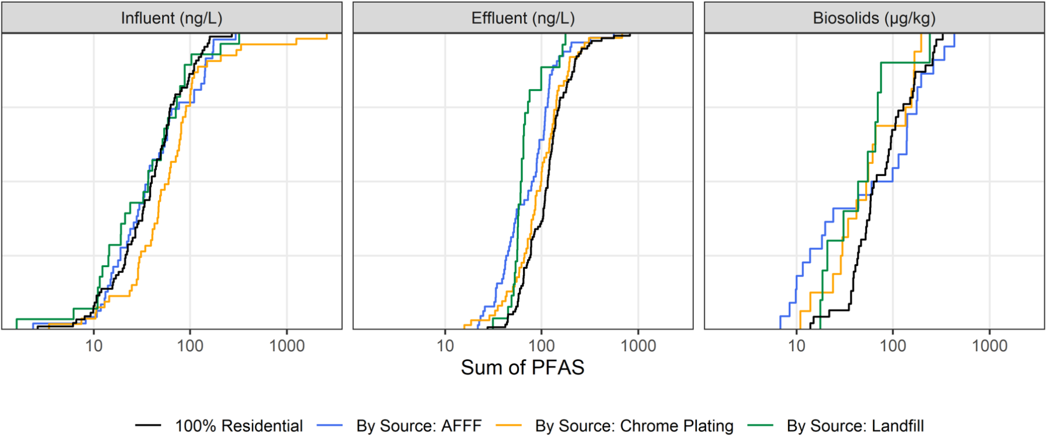
Detections Ranked from Low Concentration to High

Slide 17
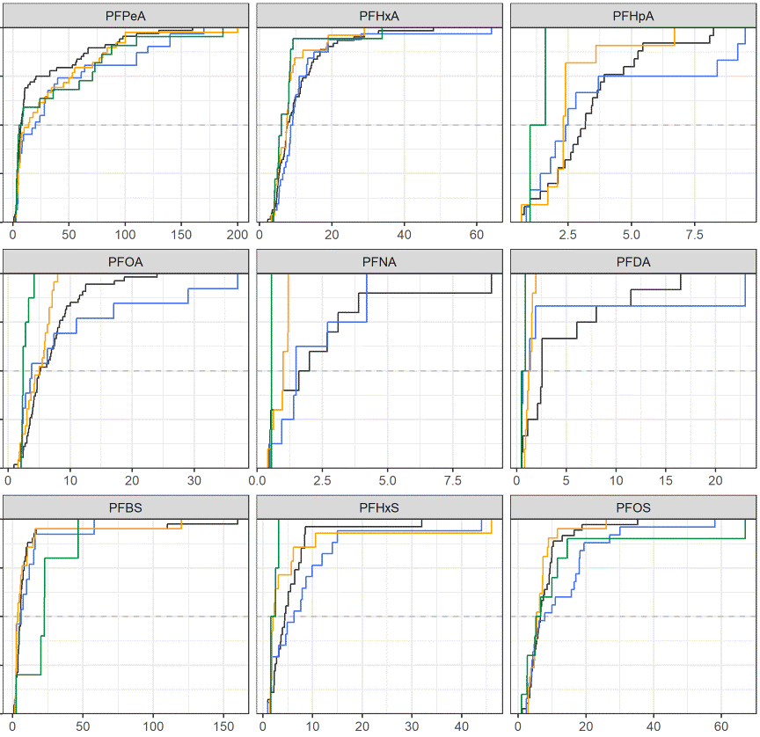
Influent
Detections Ranked from Low Concentration to High

Slide 18
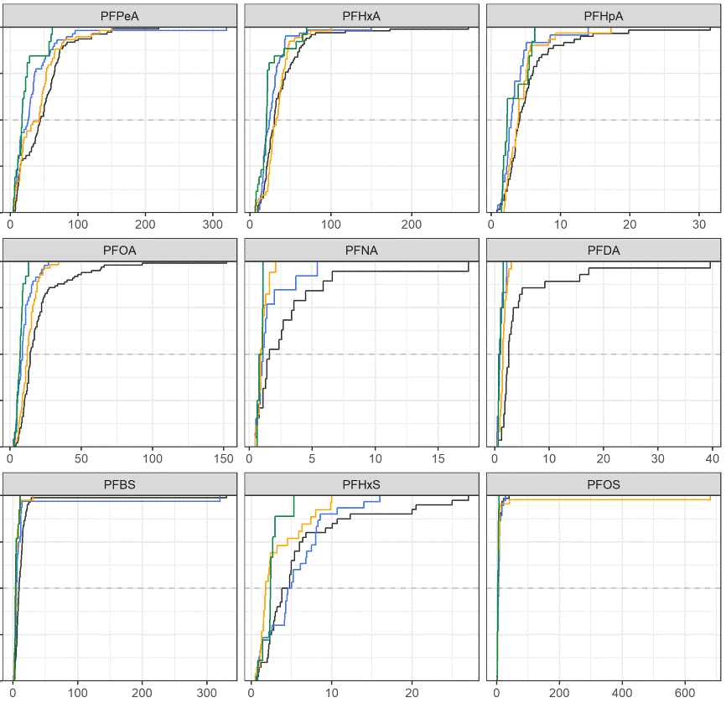
Effluent
Detections Ranked from Low Concentration to High

Slide 19
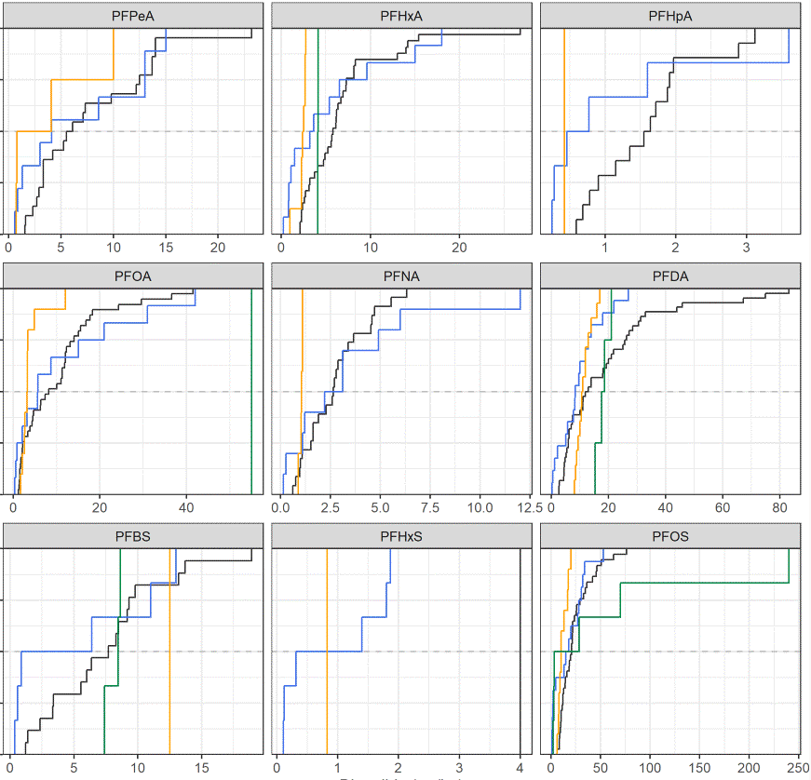
Biosolids
Detections Ranked from Low Concentration to High

Slide 20
Research Questions
What is a PFAS “baseline” for POTWs?
Do industrial discharges create PFAS above baseline?
Are there PFAS signatures of industrial point sources?
Where are the “outliers”?
What are the blind spots or major uncertainties in the dataset?

Slide 21
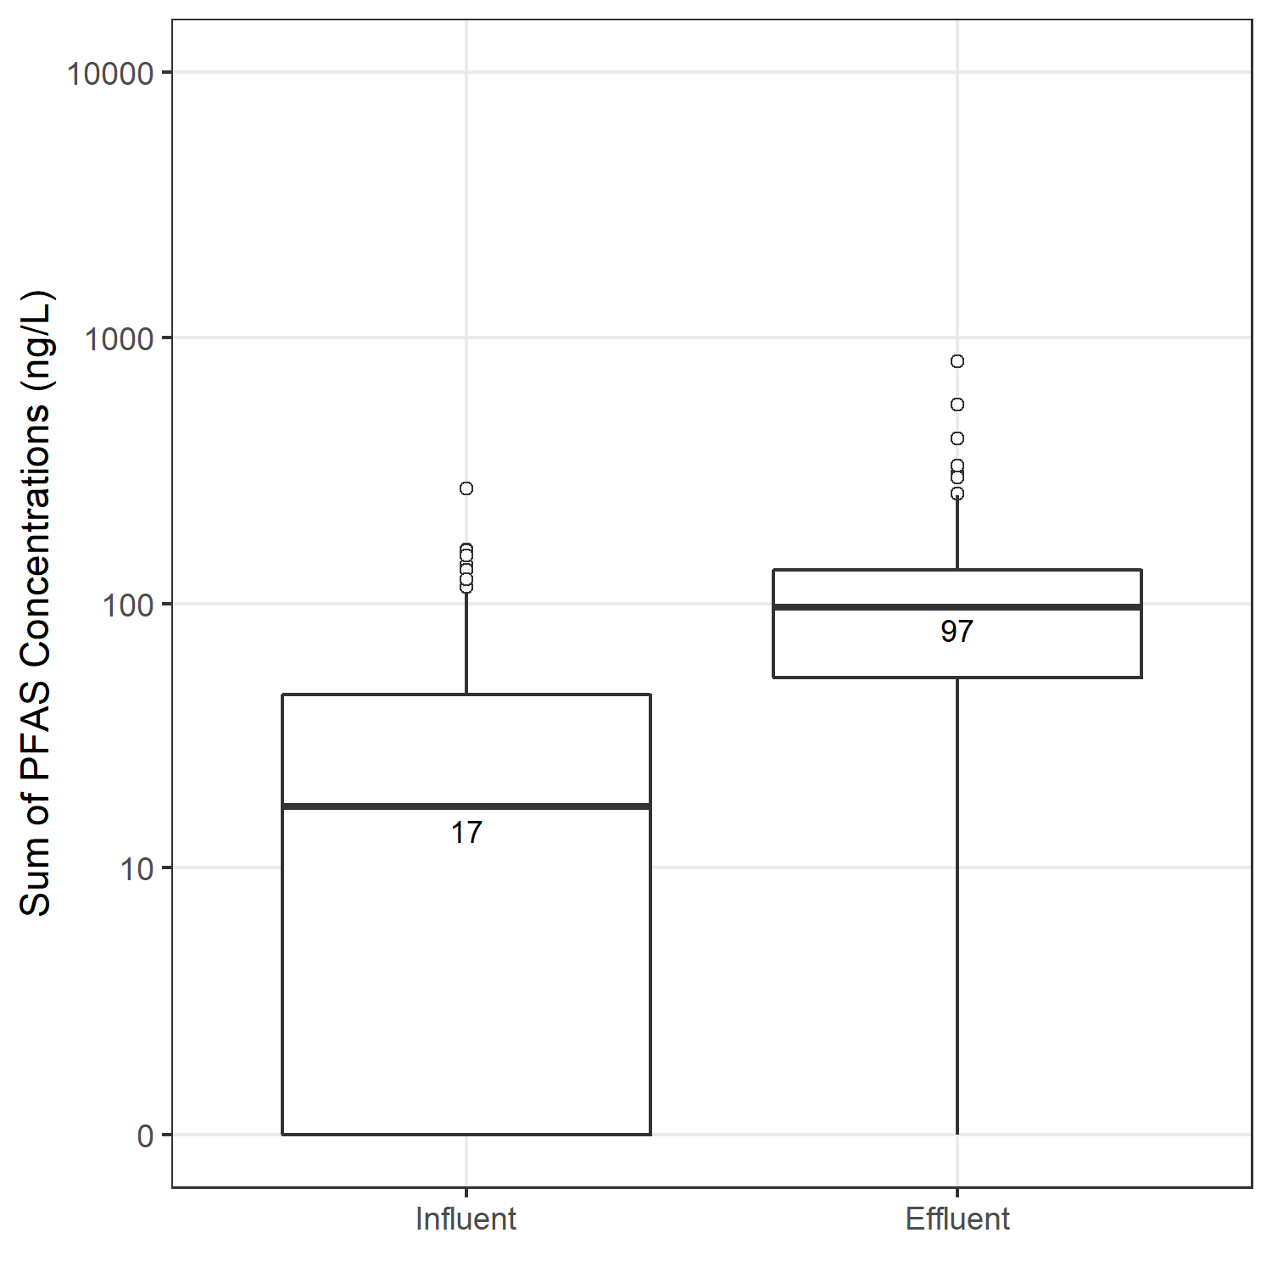
“Outlier” POTWs are visible in the data
State-wide samples
POTWs with 100% residential & commercial flow
Preliminary
∑quantified PFAS for each sample
“Non-detect to 0” case

Slide 22
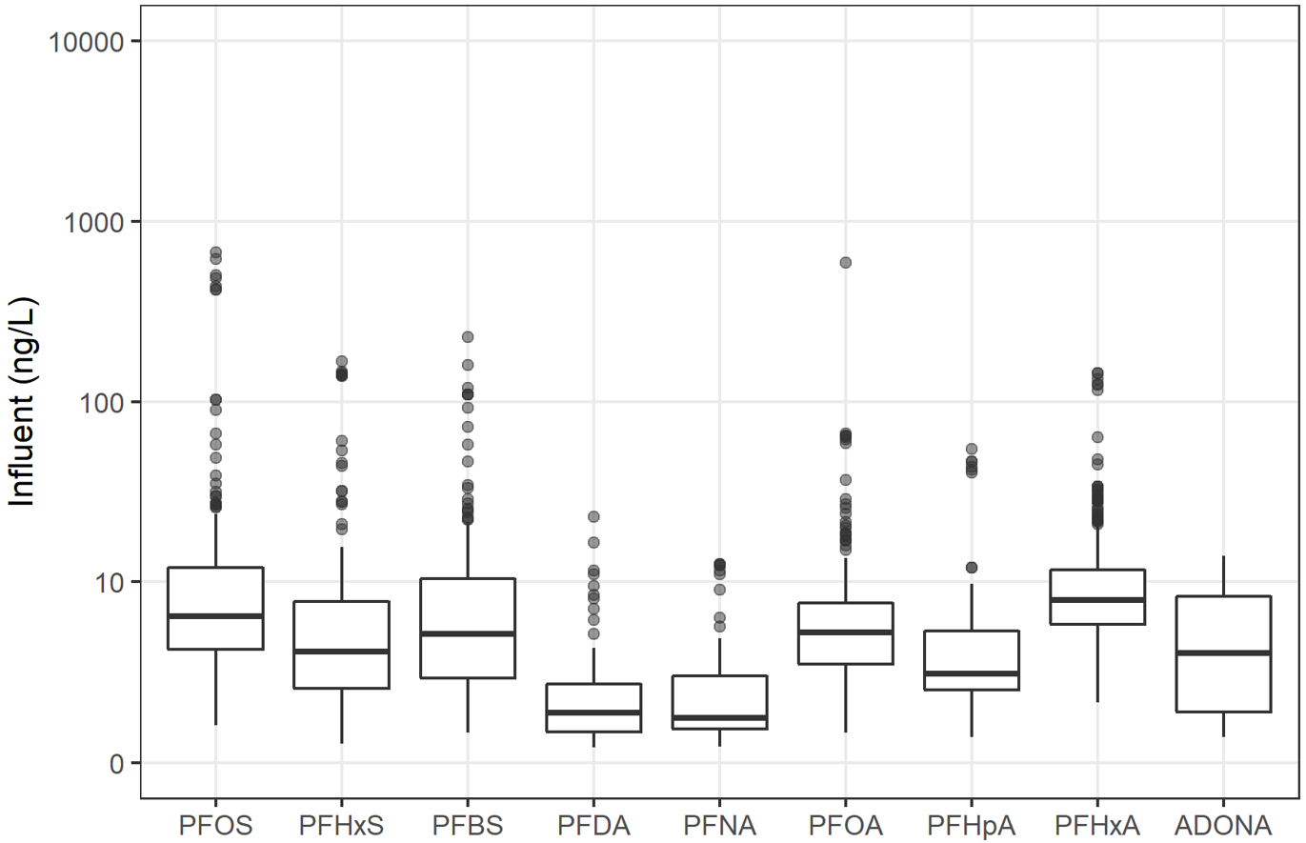
Influent
Detections Only

Slide 23
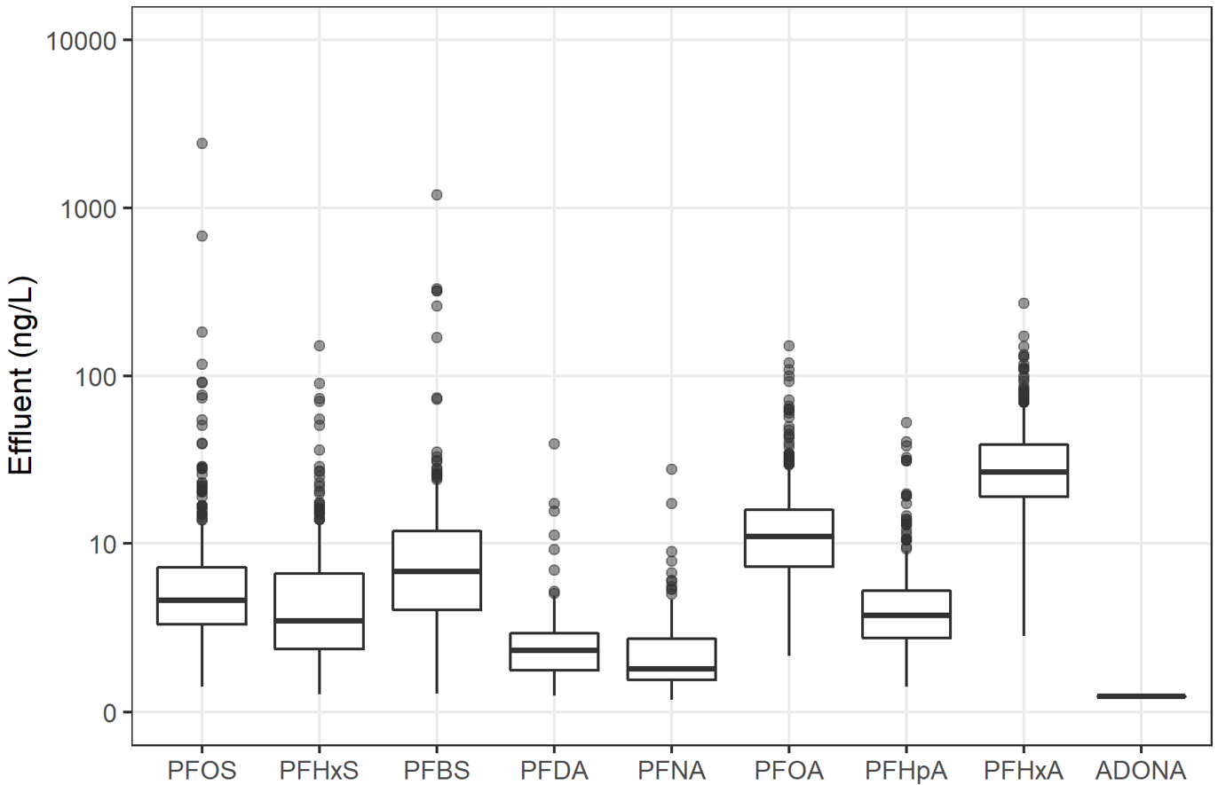
Effluent
Detections Only

Slide 24
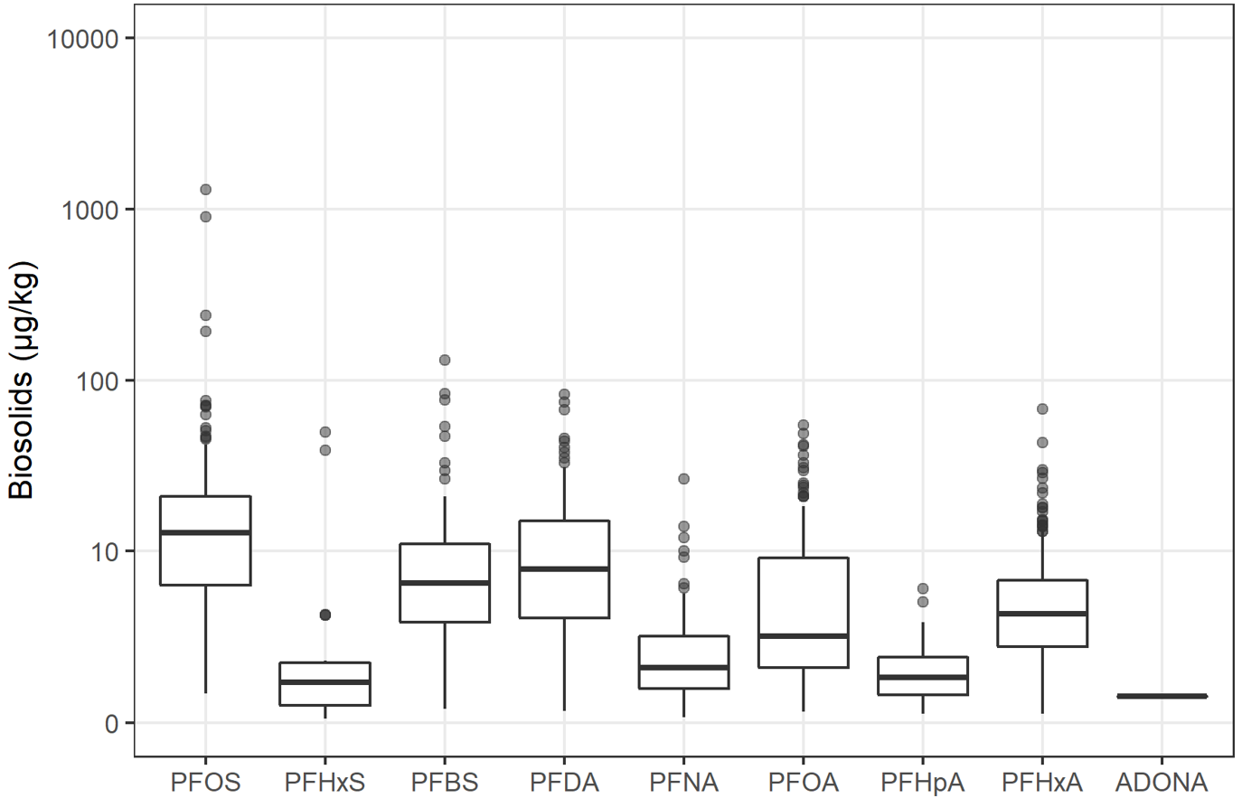
Biosolids
Detections Only

Slide 25
Research Questions
What is a PFAS “baseline” for POTWs?
Do industrial discharges create PFAS above baseline?
Are there PFAS signatures of industrial point sources?
Where are the “outliers”?
What are the blind spots or major uncertainties in the dataset?

Slide 26

Uncertainties and Blind Spots
NDs need to be handled with care
Wastewater is a complex matrix.
Difficult to analyze chemically.

Slide 27
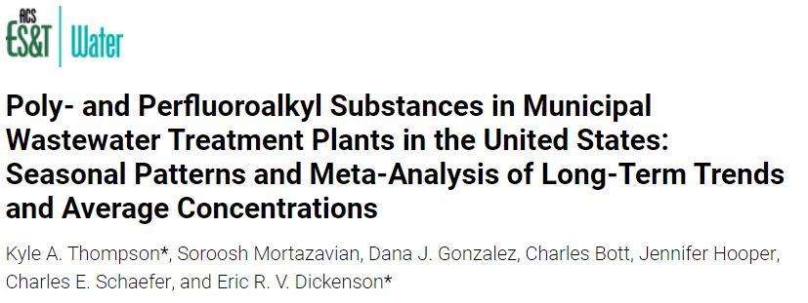
WRF 5031, Occurrence of PFAS in US Wastewater Treatment Plants
We continue to work on:
Outliers
Signatures of industrial contributions
Signatures of residential contributions

Slide 28

Thank you
Chris Gurr, PE gurrc@cdmsmith.com

